Slide 1

Django REST Framework Part 1
Introduction to RESTful APIs, Setting up Django REST Framework, Creating API Endpoints
Program: EDGE-CSE CUET DIGITAL SKILLS TRAINING
Course: Python (Django) [Intermediate]
Lecture: Training Session-11 Date: 18th October, 2024 Duration: (2+2) hours
Instructor: Tanveer Rahman, Sr. Software Engineer, Friends Corp. Chuo-ku, Tokyo, JP shakil10vr@hotmail.com, 01626735005

Slide 2
Agenda
Introduction to RESTful APIs
Setting up Django REST Framework
Creating API Endpoints
Practical Tasks

Slide 3
Introduction to RESTful APIs
REST (Representational State Transfer):
Key Concepts:
Architectural style for designing networked applications.
Uses standard HTTP methods like GET, POST, PUT, DELETE.
Resources: Data entities (e.g., users, products).
Endpoints: URL paths to access resources.
TTP Methods: Define operations on resources (CRUD).

Slide 4
Why Use REST APIs?
Separation of client and server: Allows independent development.
Scalability: Each resource can be managed independently.
Flexibility: Supports different formats like JSON, XML.
Stateless Communication: Each request is independent.

Slide 5
Introduction to Django REST Framework (DRF)
Features:
Components:
Authentication and permissions.
Serialization for converting complex data types.
Serializers: Convert data between JSON and Django models.
Views: Handle requests and responses.
Routers: Automatically generate URL routes for views.
Django REST Framework is a powerful toolkit for building Web APIs in Django.
Browsable API for easier testing and debugging.

Slide 6
Setting Up Django REST Framework
Install DRF using pip:
pip install djangorestframework
Add 'rest_framework' to INSTALLED_APPS in settings.py:
INSTALLED_APPS = [
...
'rest_framework’,
]
Configure DRF settings (optional):
REST_FRAMEWORK = {
'DEFAULT_PERMISSION_CLASSES': [
'rest_framework.permissions.AllowAny',
],
'DEFAULT_RENDERER_CLASSES': [
'rest_framework.renderers.JSONRenderer',
'rest_framework.renderers.BrowsableAPIRenderer',
],
}

Slide 7
Task 1 - Setting Up DRF (30 mins)
Install Django REST Framework in your Django project.
Add 'rest_framework' to the INSTALLED_APPS in the settings.py file.
Run the development server and ensure there are no errors.

Slide 8
Creating Your First API Endpoint
Create a Django app (e.g., books) for API development:
python manage.py startapp books
Define a simple model (e.g., Book with fields for title and content).
Create a serializer for the model:
from rest_framework import serializers
from .models import Book
class BookSerializer(serializers.ModelSerializer):
class Meta:
model = Book
fields = ‘__all__'

Slide 9
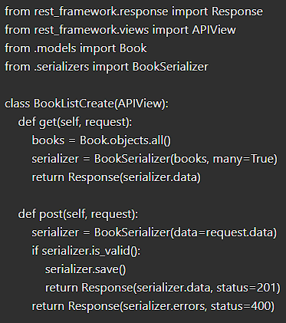
Writing Views for the API
Use DRF's built-in views (e.g., APIView or GenericAPIView).
Create a basic view for listing and creating posts:

Slide 10
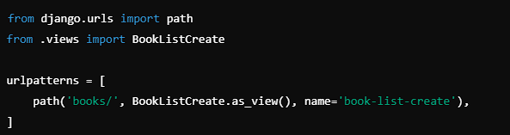
Configuring URL Routing for API Endpoints
Add URLs for the API in books/urls.py:
Include the app's URLs in the main urls.py

Slide 11
TASK 2- Creating API Endpoints (45 mins)
Create a new Django app and define a simple model (e.g., Author, Publisher).
Create a serializer and API view to handle GET and POST requests for the model.
Set up URL routing and test the endpoints using Django's browsable API.

Slide 12

Q&A Session

